Slide 1

NETAJI TEA & CAFE
WE ARE INVITING ALL OUR ENTREPRENEUR FRIENDS WHO DREAM OF OWNING A BUSINESS INTO OUR FAMILY!
Netaji Chai is a new age brand quickly becoming popular in beverages industry among the millennials and Gen Z across cities. Our success story is illustrated by the 7,00,000+ Chai that we have sold across our outlets in a short span of time. We currently have outlets across Pune & Aurangabad. More coming up soon in Mumbai, Navi Mumbai, Nashik, Patna & Delhi.

Slide 2
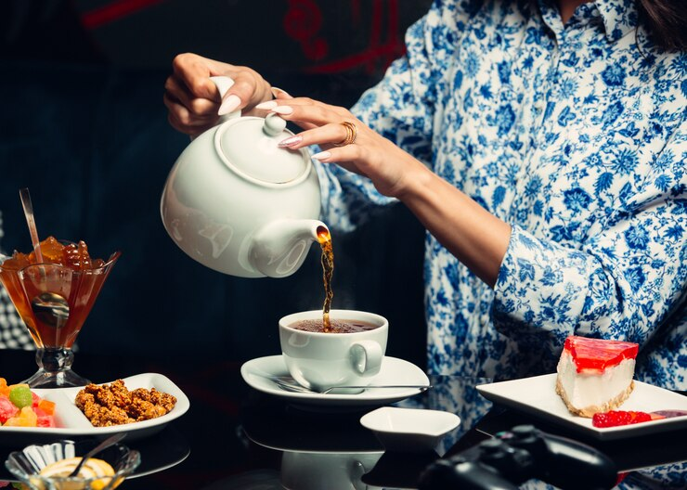

NETAJI TEA & CAFE
OUR MISSION
HONESTY, QUALITY IN WORK-PLACE RESPECT FOR PEOPLE AND ENVIRONMENT.
OUR VISION
INNOVATE & BRING IN BEST OF CLASS TEA ACCEPTABLE TO THE MILLENIALS

Slide 3

Partner In Growth Taking Entrepreneurship To New Heights
AVERAGE
INVESTMENT
AVERAGE
AREA
8-30 lacs
50-1500 sq Ft

Slide 4
NETAJI TEA & CAFE
FRANCHISOR PART
Access to SOPs
Menu List
Training of Manpower
Ongoing Support and Audits
FRANCHISEE PART
Franchisee Fee
Finding Suitable Location
Fixtures, Equipments, Glow Signs
Hiring Manpower.

Slide 5


Chai Franchise Supports
Benefits of partnering with a Brand
Brand name & Franchise support
Dashboard/software support
Training program for 6-10 days at store location
Support in product supply
HR Support (Technician/ Staff Hiring)
Training for 10 Days Café
Inspection and Property Agreement
24 x 7 Toll-Free Number with Customer care support.
Printed T-shirts, Caps, Batch for Employees
Marketing Material Design Support
Social Media Integration support
Launching Event Support with Options

Slide 6

Why Choose Us
Countless flavors available to enrich your love for tea
Served with a delectable range of tea beverages
Affordable rates
Tea for every mood and occasion
Preserving the authentic taste of tea
Serving tea with the best-in-industry ways
Bringing back the tea trend taken over by coffee and other ready-to-have drinks
NETAJI TEA & CAFE

Slide 7
Thank You
Netaji Tea & Cafe delivers a powerful array of brand services, encompassing brand usage, organic visibility, online and offline marketing campaigns, along with topnotch call, chat, and mail-based support, as well as valuable education and assistance. All of this along with the brand usage licence is available to franchisees at an unbeatable franchise fees of just Rs. 1,00,000 !! No sneaky royalties, no hidden charges whatsoever! It's all included, right here, right now!
www.silver-bowsmo.com

